Slide 1



AN ENSEMBLED MACHINE LEARNING MODEL FOR PREDICTION OF STUDENTS DROPOUT IN NIGERIAN UNIVERSITIES IYIMOGA JOSEPH NANA
20/61871U/1 DEPARTMENT OF COMPUTER SCIENCE
FACULTY OF COMPUTING, ATBU

Slide 2
INTRODUCTION
Student dropout is a persistent higher-education challenge with academic, social and economic consequences.
Dropout prediction uses historical student data to estimate the likelihood that a student may not complete a programme.
Relevant indicators can include academic performance, educational background, demographic and socioeconomic factors.
Machine learning can support earlier risk screening by identifying patterns that are difficult to monitor manually at scale.

Slide 3
BACKGROUND OF THE STUDY
Student reduction wastes resources and unused human potential.
Non-academic factors contribute more to dropout than academic ones.
Cost of living and ASUU strikes disrupt study momentum.
Current manual monitoring by lecturers is slow.
Scalability is impossible for campuses with over 50,000 students.
Machine learning offers a data-focused early-warning system.

Slide 4
PROBLEM STATEMENT
Lack of automated systems to predict dropout risks accurately.
Interventions occur too late, usually after academic damage is done
Manual observation is slow and fails to scale effectively.
Limited research on dropout prediction in developing countries.

Slide 5
MOTIVATION
Support earlier identification of students who may require attention
Demonstrate a practical application of machine learning to an educational problem.
Provides a functional prototype for academic advisers and student affairs.
Extends theoretical research by deploying an accessible web-based interface..
Create a foundation for future validation with Nigerian institutional data and integration with university information systems.

Slide 6
AIM & OBJECTIVES
AIM
OBJECTIVES
To design, implement and deploy a machine-learning-based system for predicting student dropout risk through a user-friendly web application.
Analyze factors associated with student dropout
Apply feature selection to identify the most significant risk variables.
Develop three machine learning classifiers (LR, RF, and SVM).
Evaluate performance and deploy the system using Streamlit.

Slide 7
SCOPE & LIMITATIONS
SCOPE
LIMITATIONS
Covers the full ML pipeline from preprocessing to web deployment.
Utilizes three classification algorithms for comparative performance.
Input fields are specifically adapted to the Nigerian university context.
Outcome Categories: "Likely to Graduate" or "At Risk of Dropout."
Reliance on UCI Portuguese dataset due to local data privacy constraints.
System predicts dropout after the first year, not at admission point.
Required features like semester results are only available after Year 1.
Streamlit free hosting limits concurrent users and available memory.

Slide 8
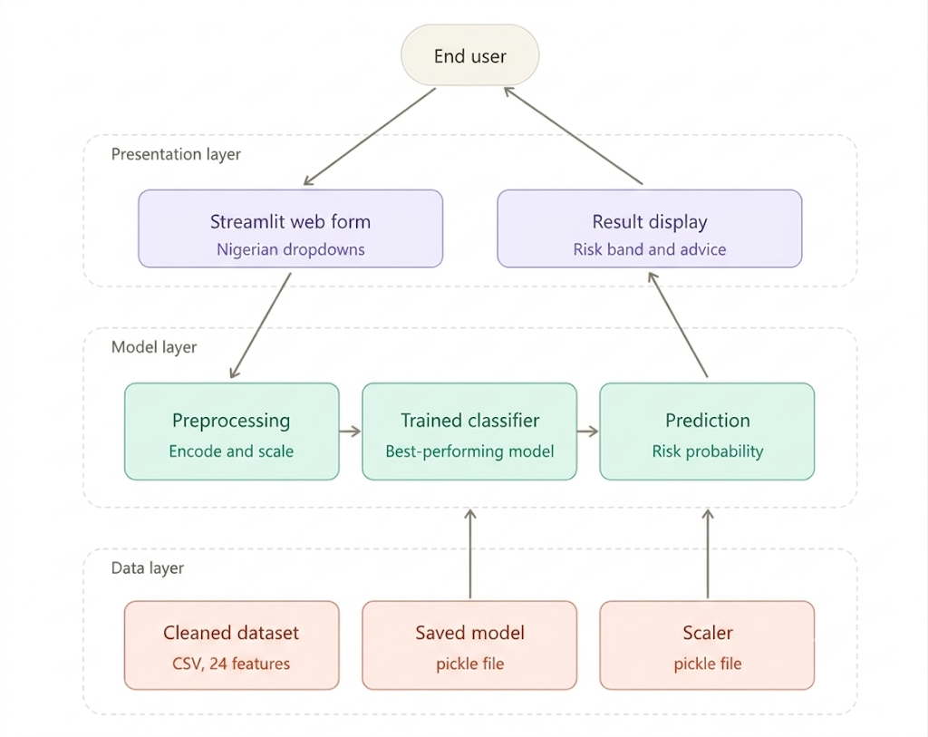
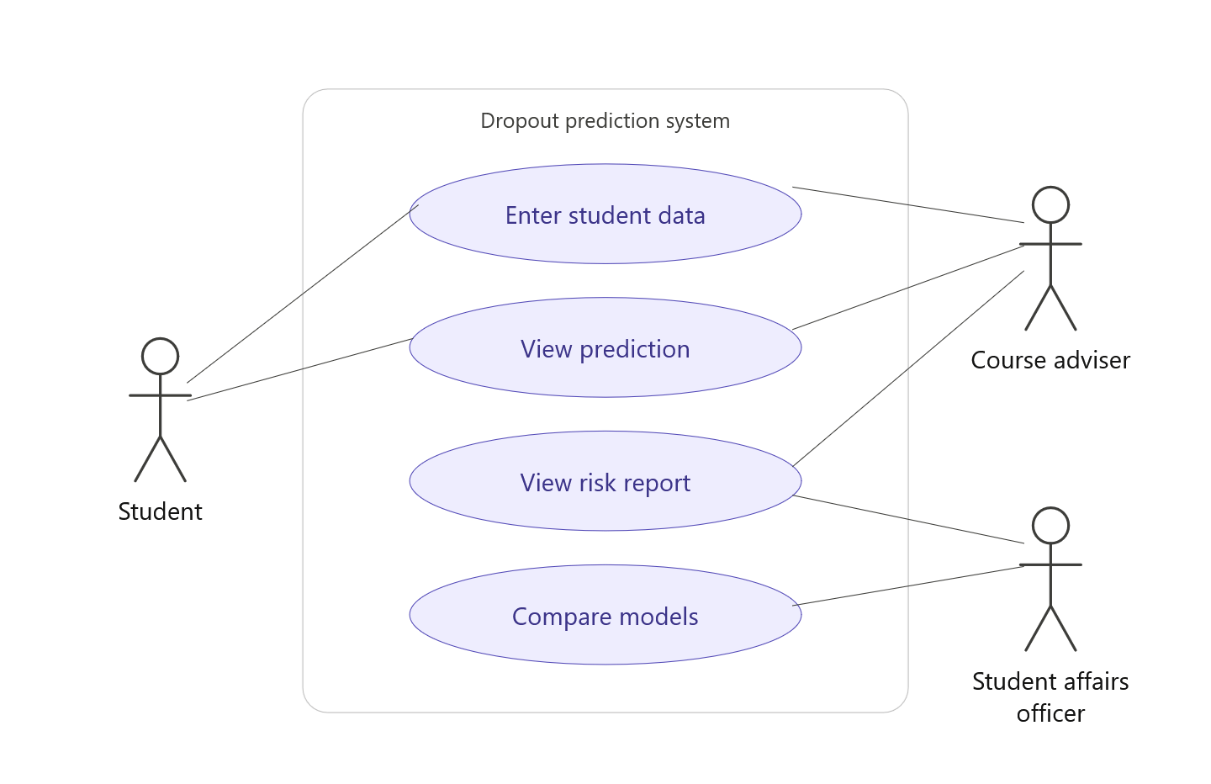
PROPOSED SYSTEM/METHODOLOGY
Figure 5.1: Proposed System Architecture
Figure 5.2: Use Case Diagram of the Proposed System

Slide 9
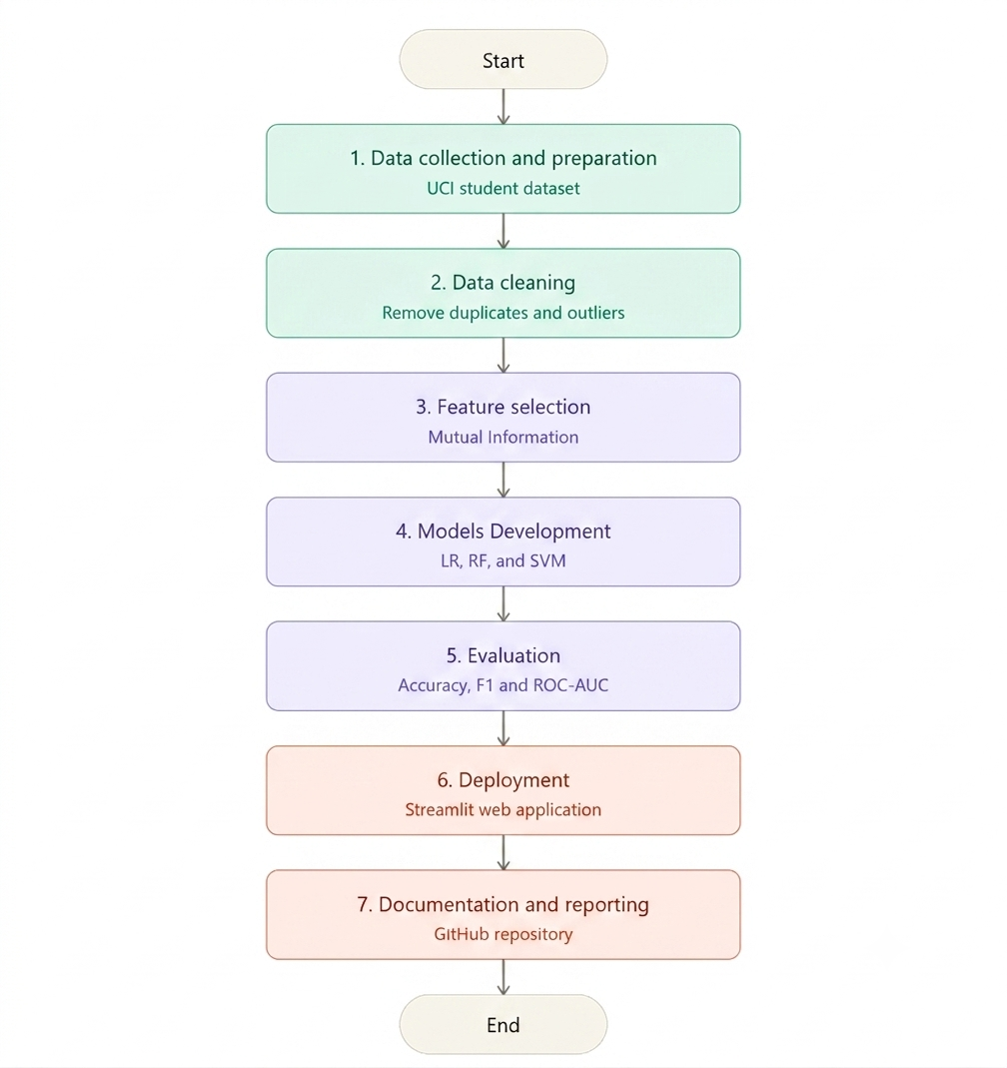
PROPOSED SYSTEM/METHODOLOGY
SDLC Model: Waterfall Model ML Methodology: KDD-inspired process Learning Task: Supervised binary classification
Figure 5.3: Flowchart of the Project Methodology

Slide 10
EXPECTED RESULTS
Cleaned dataset with approximately 24 highly predictive features.
Three trained models with documented performance comparisons.
A working Streamlit application for real-time risk assessment.
Feature-importance charts to explain model decision logic.
Public GitHub repository for reproducibility and future extension.

Slide 11
WORK PLAN
Activity | April | May | June | July | August | Sept.
Proposal writing & approval | ● | ●
Literature review | ● | ● | ●
Data collection & cleaning |  | ● | ●
Feature selection & preprocessing |  |  | ● | ●
Model training & comparison |  |  |  | ● | ●
Streamlit web app development |  |  |  | ● | ●
System testing & evaluation |  |  |  |  | ● | ●
Documentation & write-up |  |  | ● | ● | ● | ●
Final defense preparation |  |  |  |  |  | ●

Slide 12
REFERENCES
Alarape, M. A. (2021). Hybrid models for students' academic performance and dropout prediction using machine learning algorithms [Doctoral dissertation, University of Ilorin]. Department of Computer Science, Faculty of Communication and Information Sciences, University of Ilorin, Nigeria.
Bashiru, S., & Malgwi, Y. M. (2026). A machine learning-based early warning system for identifying at-risk university students in Nigerian higher education. Mambilla Journal of Science and the Environment, 10(1), 41–46.
Fatima, S., Hussain, A., Bin Amir, S., Awan, M. G. Z., Ahmed, S. H., & Aslam, S. M. H. (2023). XGBoost and Random Forest algorithms: An in-depth analysis. Pakistan Journal of Scientific Research (PJOSR), 3(1), 26–31.
Hassan, M. A., Muse, A. H., & Nadarajah, S. (2024). Predicting student dropout rates using supervised machine learning: Insights from the 2022 National Education Accessibility Survey in Somaliland. Applied Sciences, 14(17), 7593. https://doi.org/10.3390/app14177593
Jiménez, O., Jesús, A., & Wong, L. (2023). Model for the prediction of dropout in higher education in Peru applying machine learning algorithms: Random Forest, Decision Tree, Neural Network and Support Vector Machine. Proceeding of the 33rd Conference of FRUCT Association, 116–124.
Mduma, N., Kalegele, K., & Machuve, D. (2019). A survey of machine learning approaches and techniques for student dropout prediction. Data Science Journal, 18(1), 14. https://doi.org/10.5334/dsj-2019-014
Mukooyo, H., & Kasse, J. P. (2024). Towards sustainable education: A machine learning model for early student dropout prediction in higher education institutions. The Uganda Higher Education Review, 11(2), 57–68. https://doi.org/10.58653/nche.v11i2.5
Nicoletti, M. C., & de Oliveira, O. L. (2020). A machine learning-based computational system proposal aiming at higher education dropout prediction. Higher Education Studies, 10(4), 12–24. https://doi.org/10.5539/hes.v10n4p12
Osemwegie, E. E., & Amadin, F. I. (2023). Student dropout prediction using machine learning. FUDMA Journal of Sciences, 7(6), 347–353. https://doi.org/10.33003/fjs-2023-0706-2103
Valkenborg, D., Rousseau, A. J., Geubbelmans, M., & Burzykowski, T. (2023). Support vector machines. American Journal of Orthodontics and Dentofacial Orthopedics, 164(5), 754–757. https://doi.org/10.1016/j.ajodo.2023.08.003
Villar, A., & Velini de Andrade, C. R. (2024). Supervised machine learning algorithms for predicting student dropout and academic success: A comparative study. Discover Artificial Intelligence, 4(2). https://doi.org/10.1007/s44163-023-00079-z
Zhao, Z., & Ren, P. (2025). Random Forest-based early warning system for student dropout using behavioral data. Bulletin of Education and Psychology, 5(5). https://hal.science/hal-05102483v1

